Slide 1
microservices using Spring Boot

Slide 2
Monolith Applications

Slide 3
Advantages of Monolith
Simple to develop.
Simple to test.
Simple to deploy.
Simple to scale horizontally.

Slide 4
Disadvantages of Monolith
Large code base.
Scaling.
Overloaded.
Change technology.
Deployment challenges.
Big database.

Slide 5
Microservices Applications

Slide 6
Characteristics
Small, independent, and loosely coupled.
A separate codebase.
Deployed independently.
Persisting the Data.
Hybrid technologies.

Slide 7
Advantages with Microservices
Independent deployments.
Independent development.
Small, focused teams.
Fault isolation.
Change is easy.
Scaling

Slide 8
Challenges of Microservices
Bounded Context
Configuration Management
Dynamic Scale Up and Scale Down
Pack of Cards
Debugging

Slide 9
Three Frameworks
Spring Boot
Spring Cloud
Axon framework

Slide 10
Spring Cloud Modules
Dynamic Scale Up and Down.
Naming Server (Eureka)
Ribbon (Client Side Load Balancing)
Feign (Easier REST Clients)
Visibility and Monitoring
Zipkin Distributed Tracing
Netflix API Gateway ZUUL
Configuration Management
Spring Cloud Config Server
Fault Tolerance
Hystrix

Slide 13
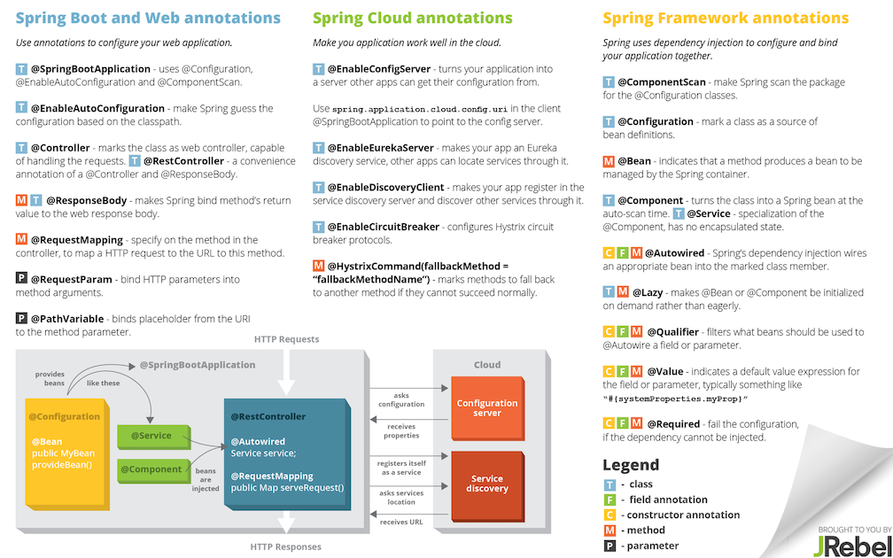

Slide 14
URLS
Application | URL
Limits Service | http://localhost:8080/limits
Spring Cloud Config Server | http://localhost:8888/limits-service/default http://localhost:8888/limits-service/dev
Currency Converter Service - Direct Call | http://localhost:8100/currency-converter/from/USD/to/INR//usr/local/var/log/rabbitmq/rabbit@localhost.log/usr/local/var/log/rabbitmq/rabbit@localhost.logquantity/10
Currency Converter Service - Feign | http://localhost:8100/currency-converter-feign/from/EUR/to/INR/quantity/10000
Currency Exchange Service | http://localhost:8000/currency-exchange/from/EUR/to/INR http://localhost:8001/currency-exchange/from/USD/to/INR
Eureka | http://localhost:8761/
Zuul - Currency Exchange & Exchange Services | http://localhost:8765/currency-exchange-service/currency-exchange/from/EUR/to/INR http://localhost:8765/currency-conversion-service/currency-converter-feign/from/USD/to/INR/quantity/10

Slide 15
POrts
Application | Port
Limits Service | 8080, 8081, ...
Spring Cloud Config Server | 8888
Currency Exchange Service | 8000, 8001, 8002, ..
Currency Conversion Service | 8100, 8101, 8102, ...
Netflix Eureka Naming Server | 8761
Netflix Zuul API Gateway Server | 8765
Zipkin Distributed Tracing Server

Slide 16
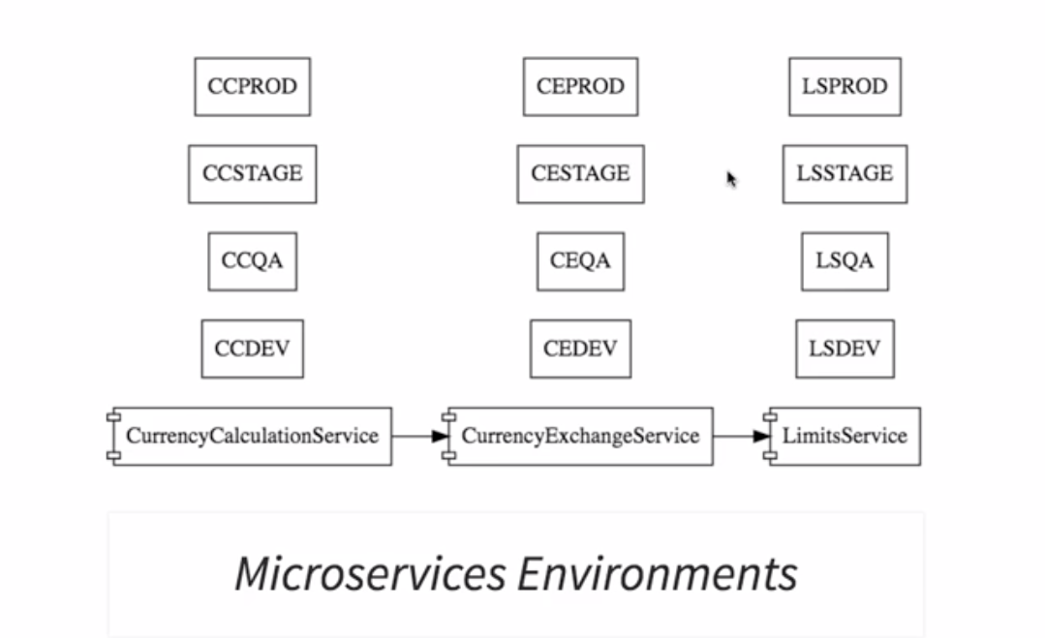

Slide 17
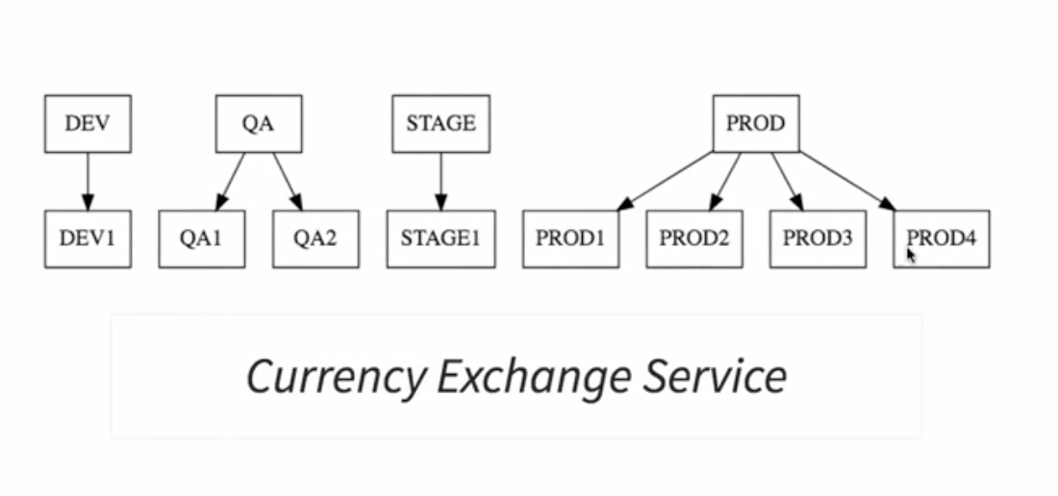
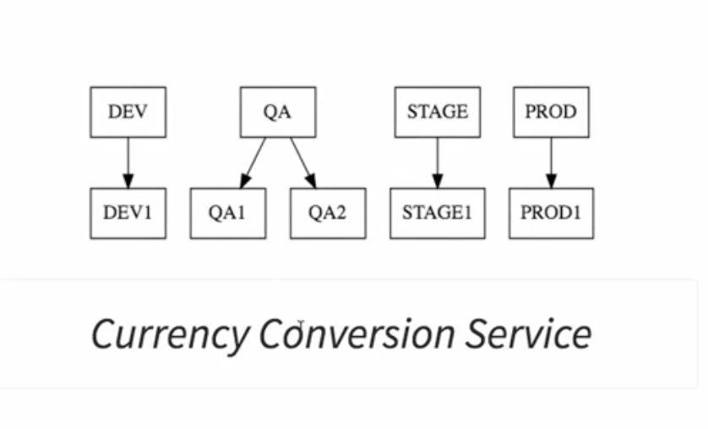

Slide 18
Limits Service
Introduction to Limits Microservice and Spring Cloud Config Server
Setting up Limits Microservice
Creating a hardcoded limits service
Enhance limits service to pick up configuration from application properties

Slide 19
Why Spring Cloud ConFig Server ?
Application configuration.
Database configuration.
Communication Channel Configuration - queues and other infrastructure.
URLs of other microservices.

Slide 20
What is SCCS
One of the popular implementations of a cloud config server.
Enables you to store all the configuration for multiple microservices for different environments in a Git or a SVN Repository

Slide 21
Setting up Spring Cloud Config server
Generate the project with DevTools and Config Server dependencies
Check pom.xml for SCCS .
Set up application name and server port in application.properties
Add Config Server Annotation
Add @EnableConfigServer

Slide 22
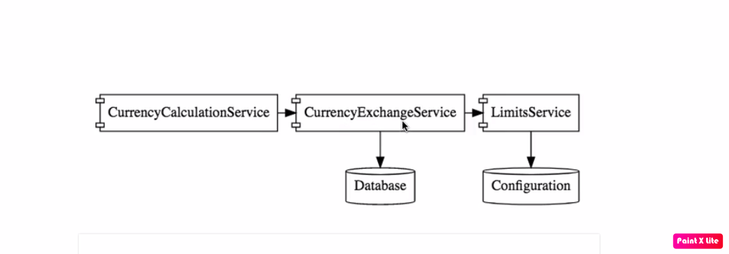

Slide 23
Currency Exchange Service
To Create Multiple Instances of the server port
-Dserver.port=8000
Spring Environment Interface
https://docs.spring.io/spring-framework/docs/current/javadoc-api/org/springframework/core/env/Environment.html

Slide 24
TO ADD JPA REPOSITORY
ADD TO POM.XML
JPA Dependency
<dependency>
<groupId>org.springframework.boot</groupId>
<artifactId>spring-boot-starter-data-jpa</artifactId>
</dependency>
H2 InMemory Database
<dependency>
<groupId>com.h2database</groupId>
<artifactId>h2</artifactId>
</dependency>

Slide 25
Make Entitiy and data file
Make the ExchangeValue.java as Entity .
Add @Entity, @Id, @Column
Add data.sql file to resources and add the queries
spring.jpa.show-sql=true
spring.h2.console.enabled=true
spring.jpa.hibernate.ddl-auto=update
spring.datasource.url = jdbc:h2:mem:testdb

Slide 26
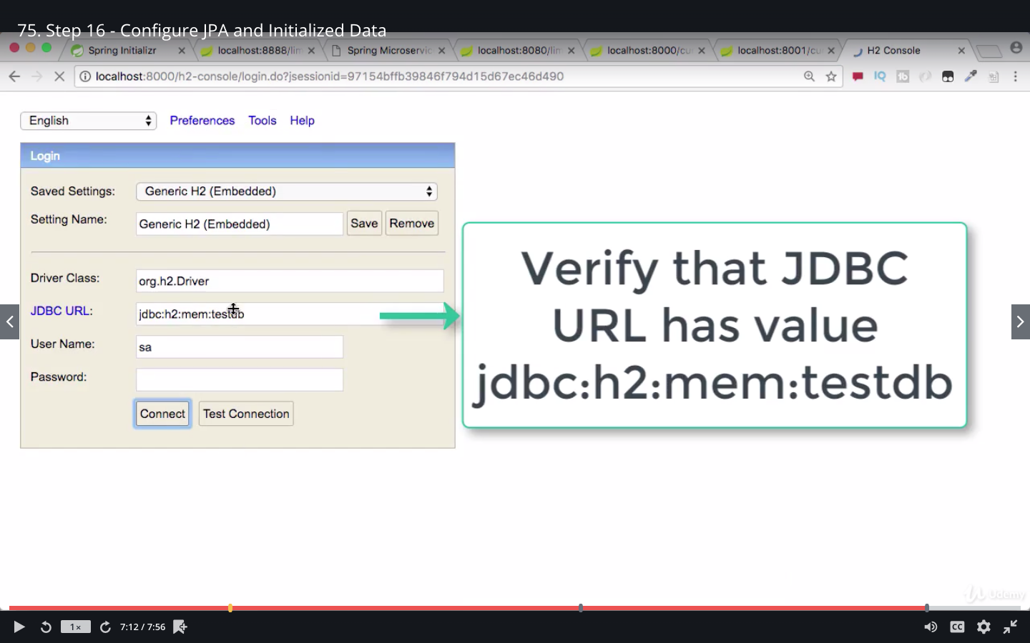
H2 Console

Slide 27
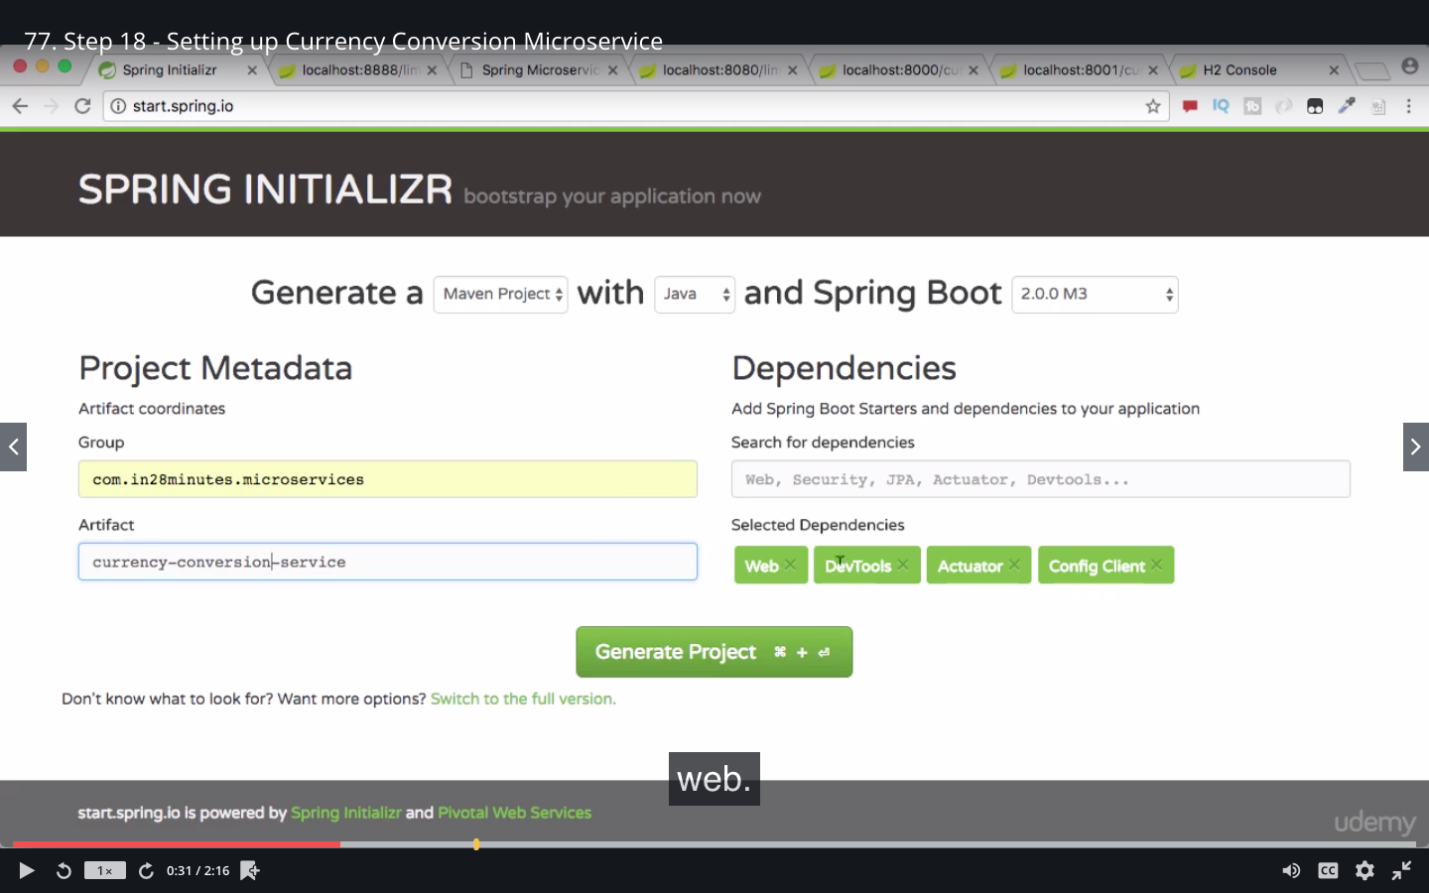
Setting up Currency Conversion service

Slide 28
What is Rest Template ?
RestTemplate is a synchronous client to perform HTTP requests.
It uses a simple, template method API over underlying HTTP client libraries such as the JDK HttpURLConnection, Apache HttpComponents, and others.
Since Spring 5.0, a new client WebClient is available that can be use do create both synchronous and asynchronous requests.
In the future releases, RestTemplate will be deprecated in favour of WebClient.

Slide 29
Rest Template Methods
Method | Spring RestTemplate’s method
Get | getForObject, getForEntity
Post | postForObject(String url, Object request, Class responseType, String…​ uriVariables) postForLocation(String url, Object request, String…​ urlVariables),
Put | put(String url, Object request, String…​urlVariables)
Delete | delete()
Head | headForHeaders(String url, String…​ urlVariables)
Options | optionsForAllow(String url, String…​ urlVariables)

Slide 30
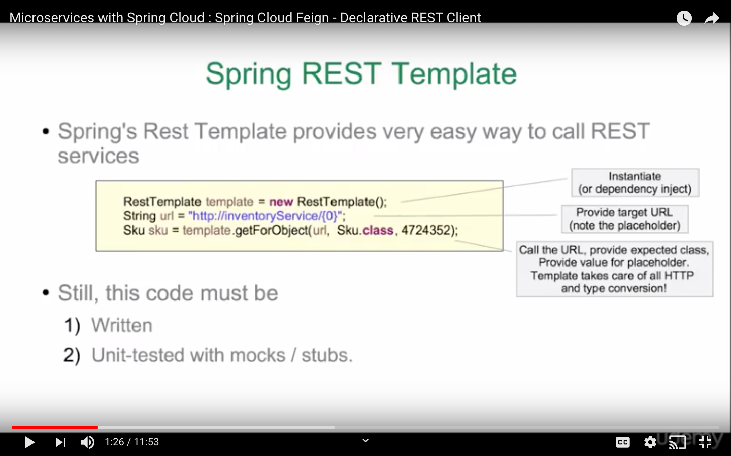

Slide 31
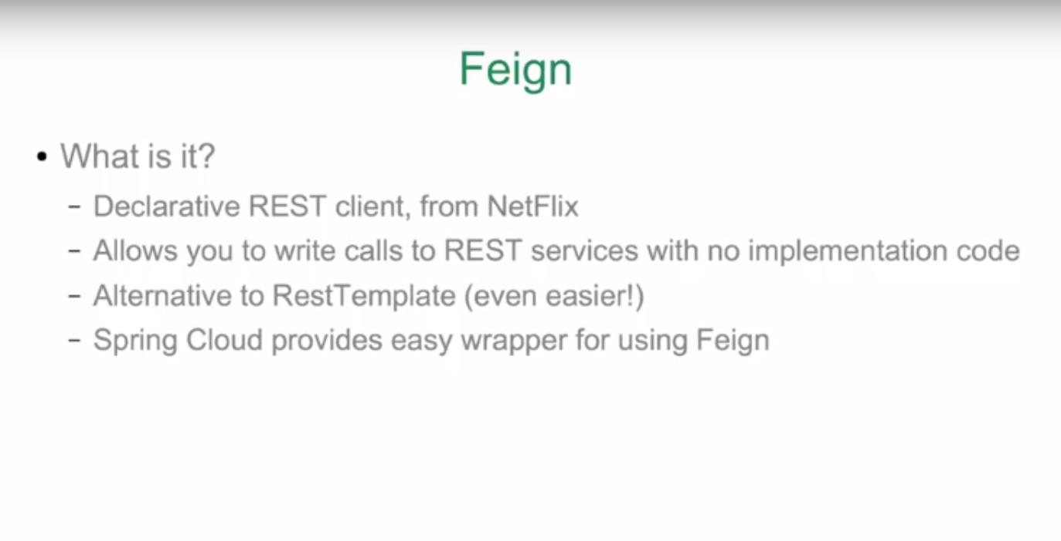

Slide 32
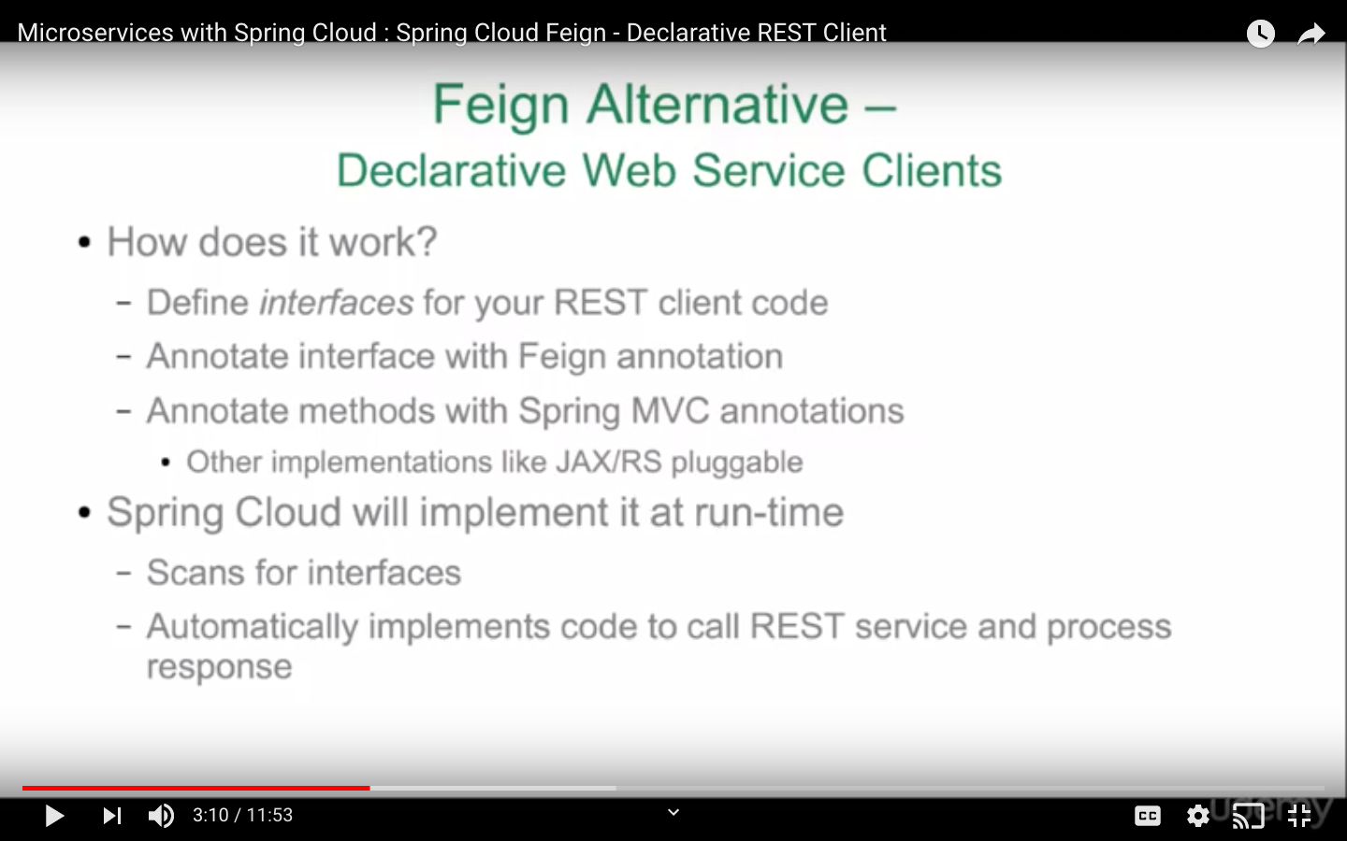

Slide 33
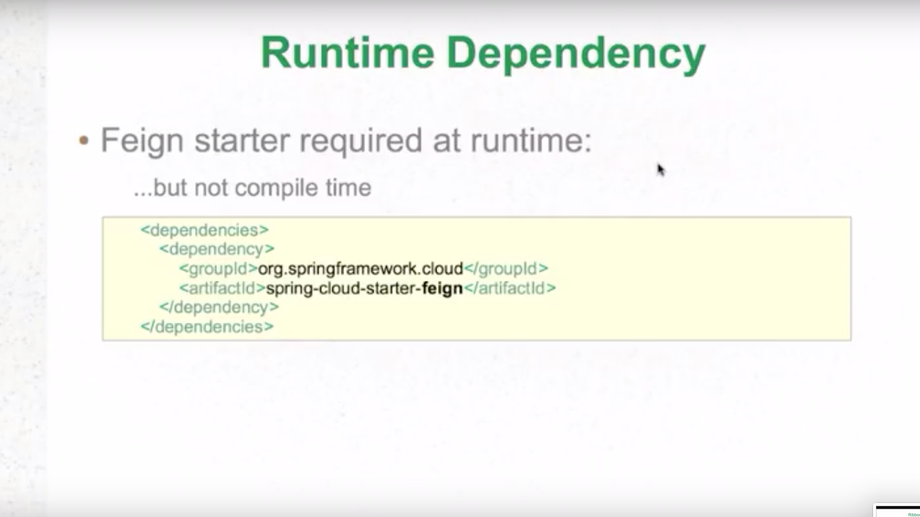

Slide 34
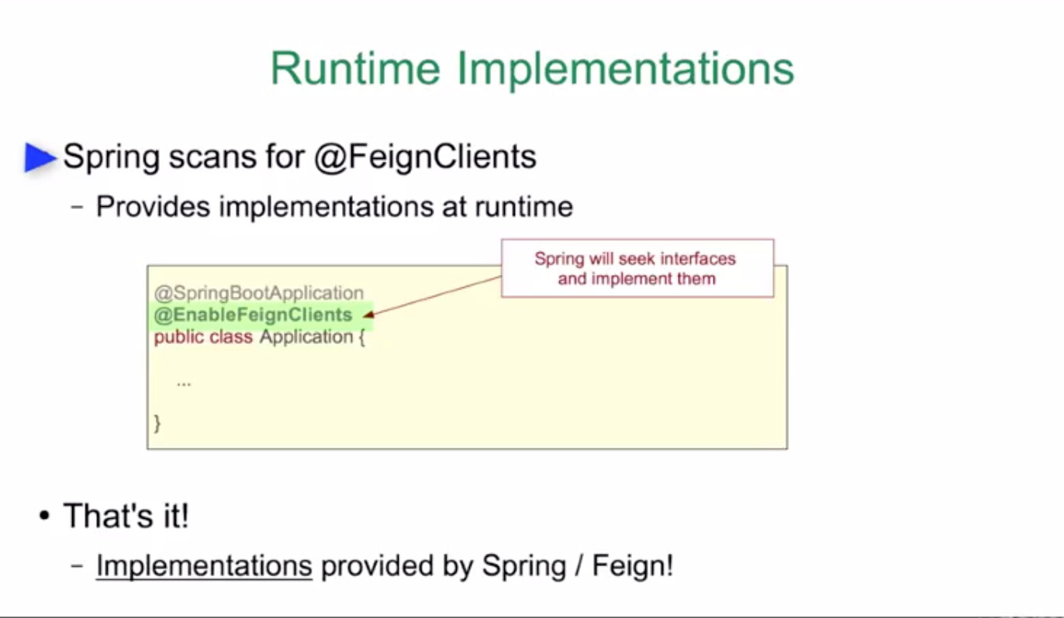

Slide 35
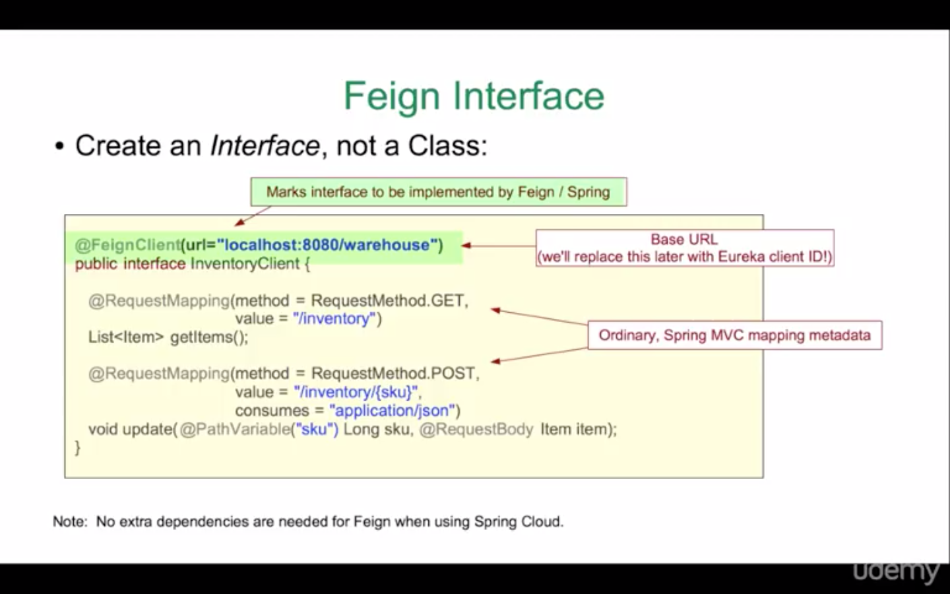

Slide 36
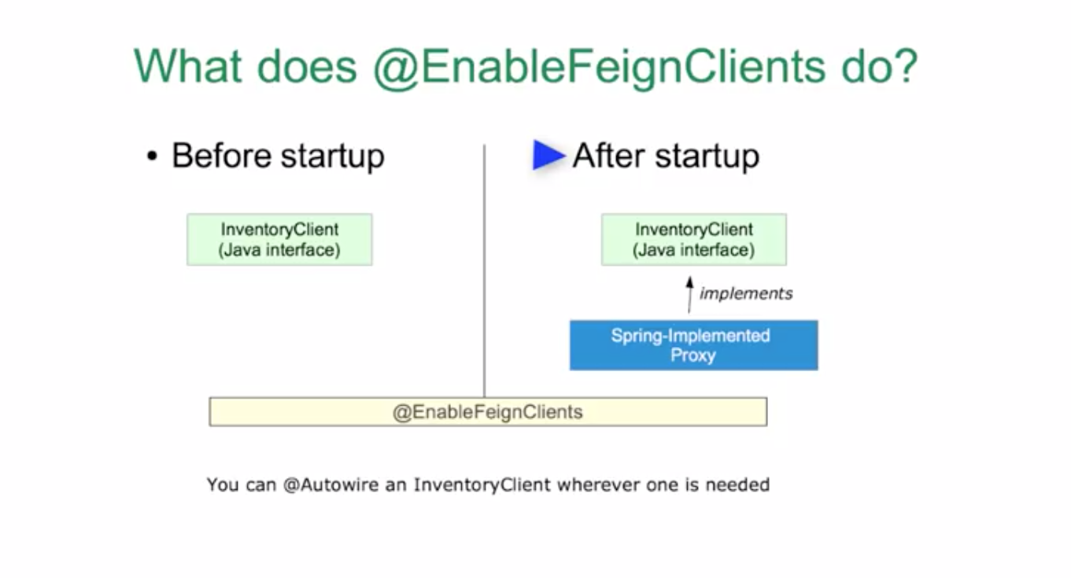

Slide 37
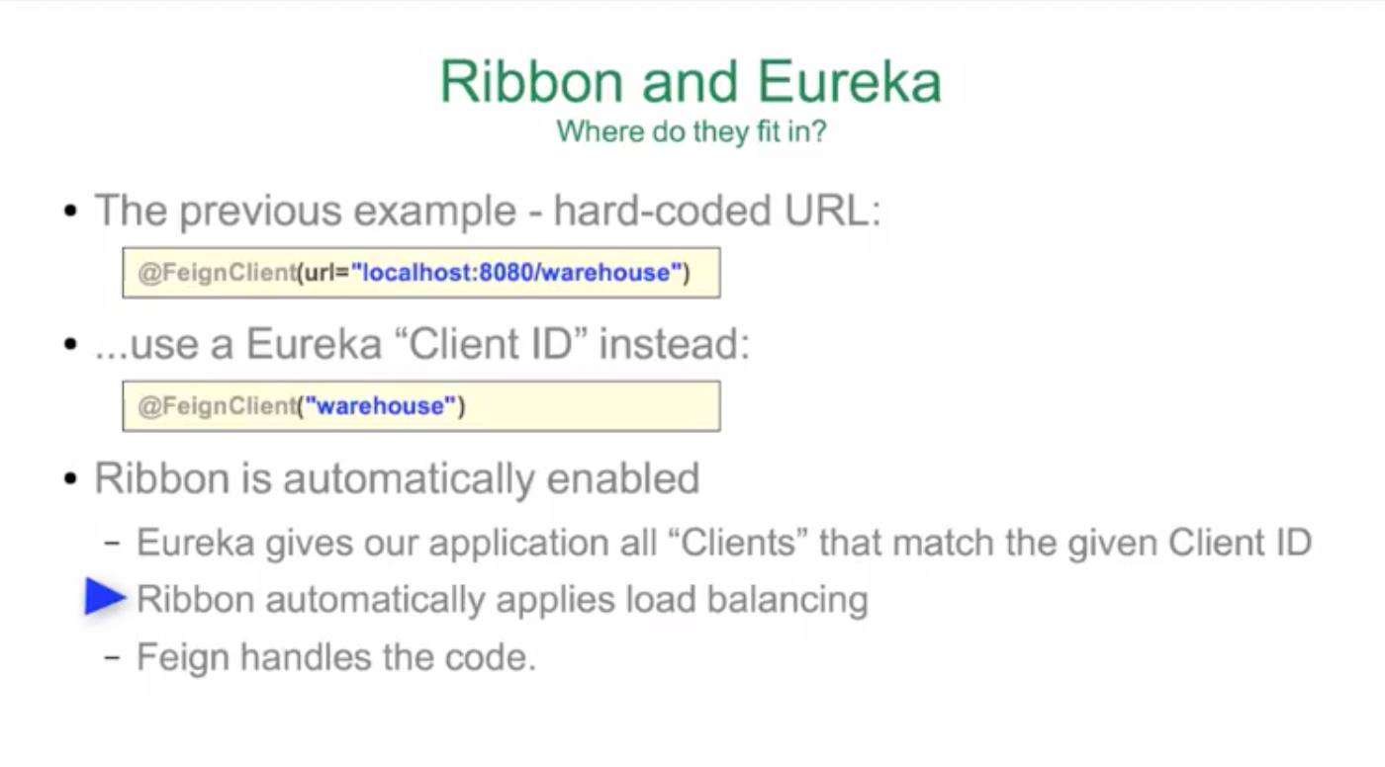

Slide 38
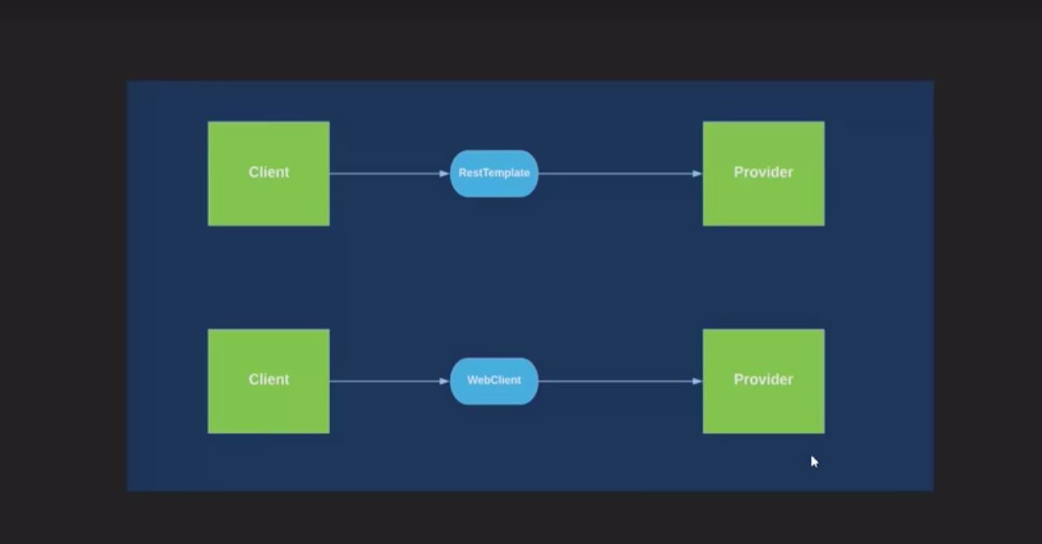

Slide 39
Introduced in Spring 5 Framework.
Reactive Programming
Asynchronous and unblocking Communication
Introduction to WebClient

Slide 41
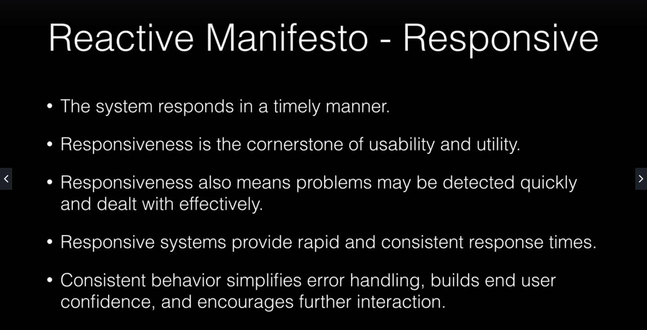

Slide 42
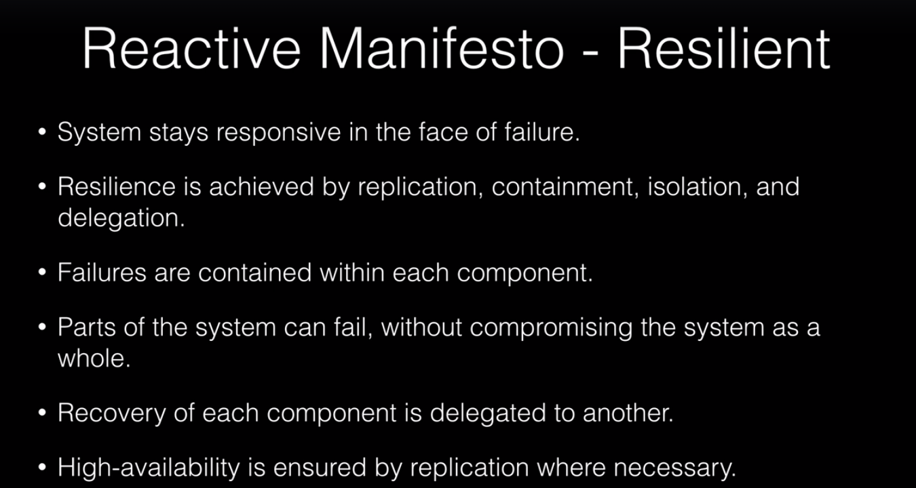

Slide 43
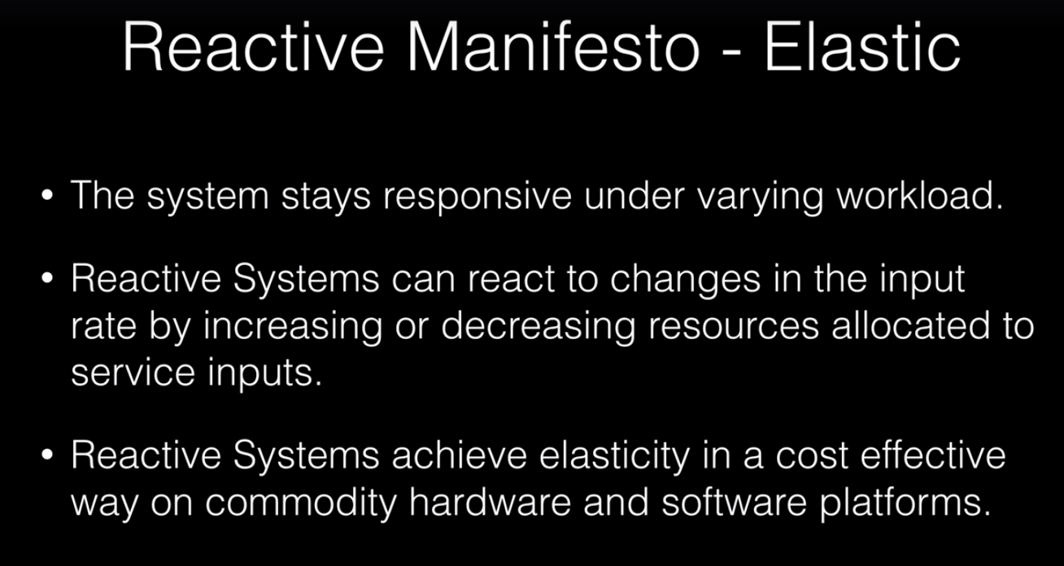

Slide 44
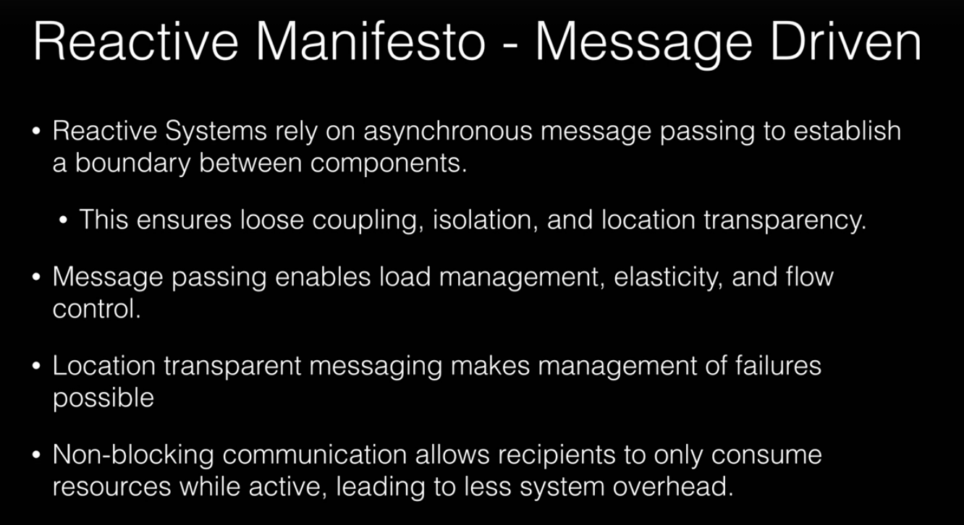

Slide 45
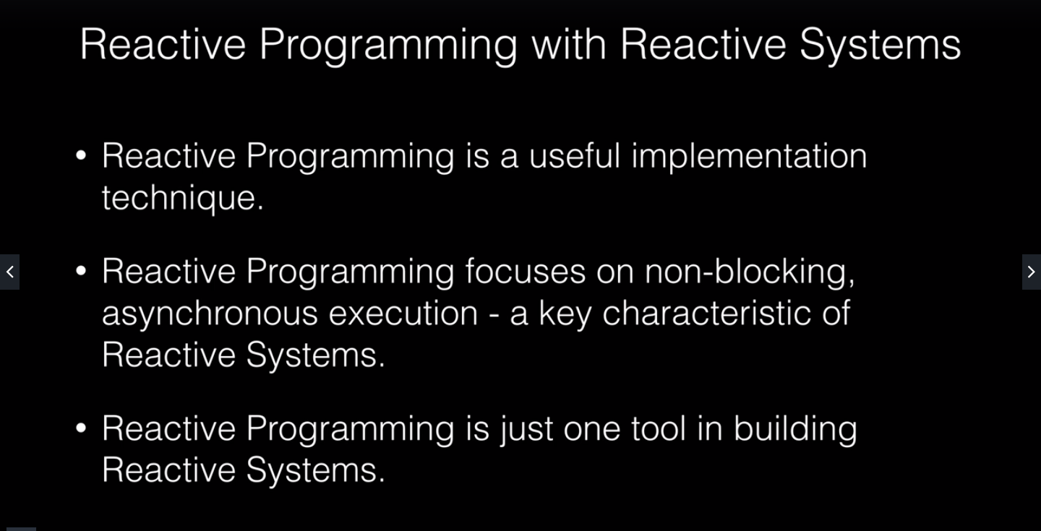

Slide 46
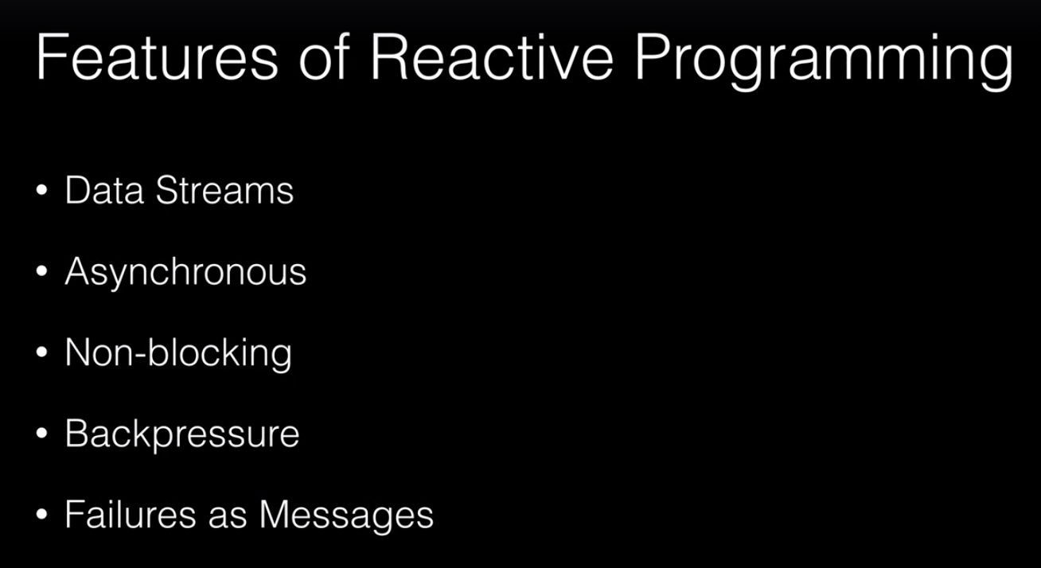

Slide 47
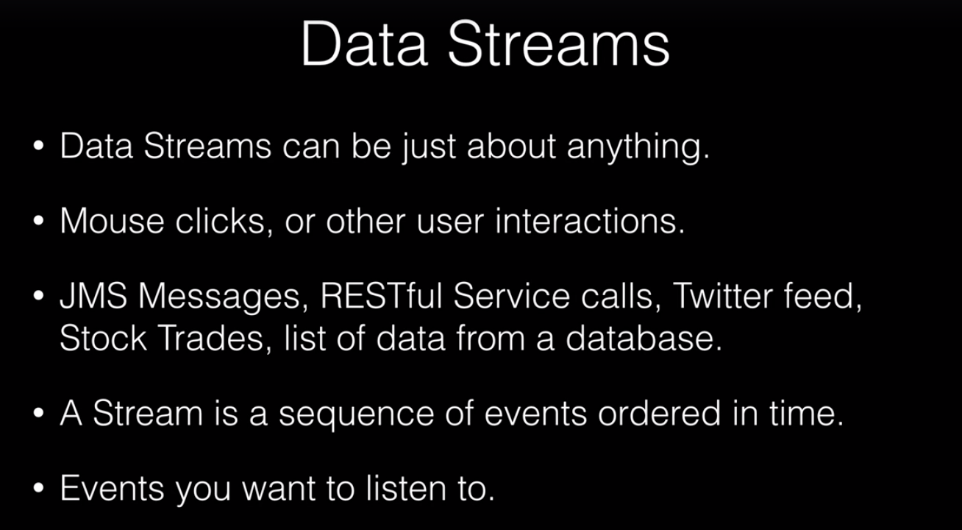

Slide 48
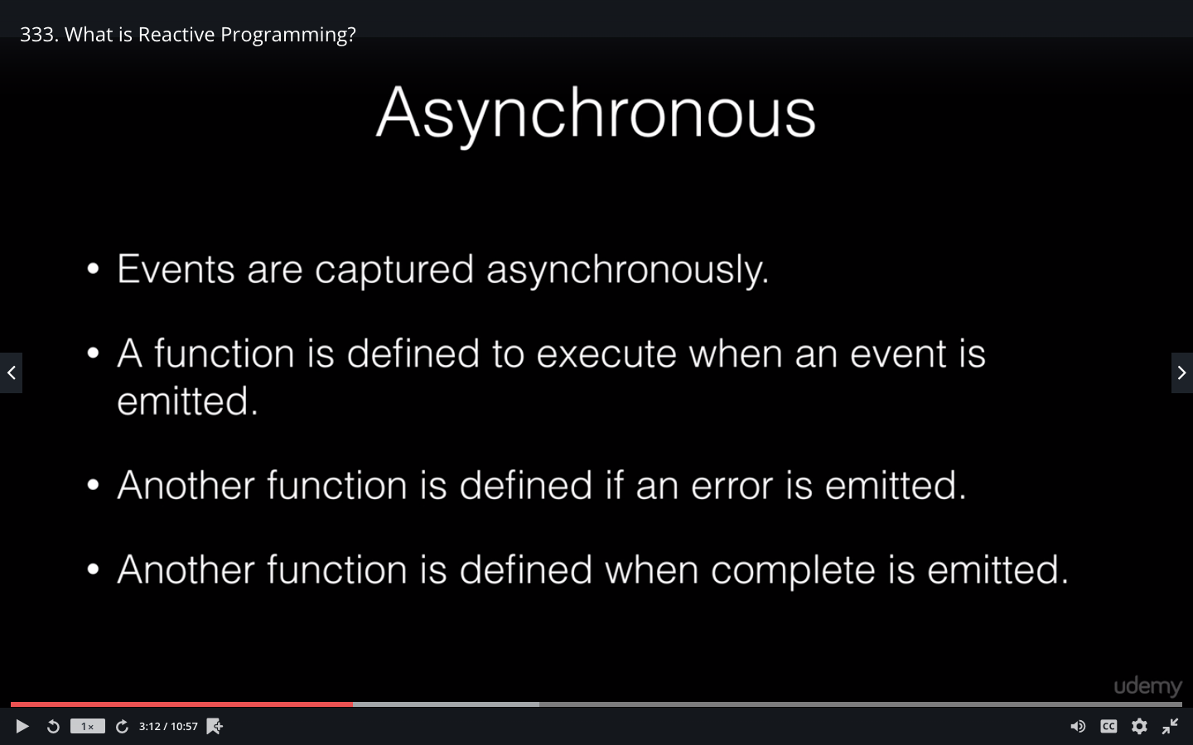

Slide 49
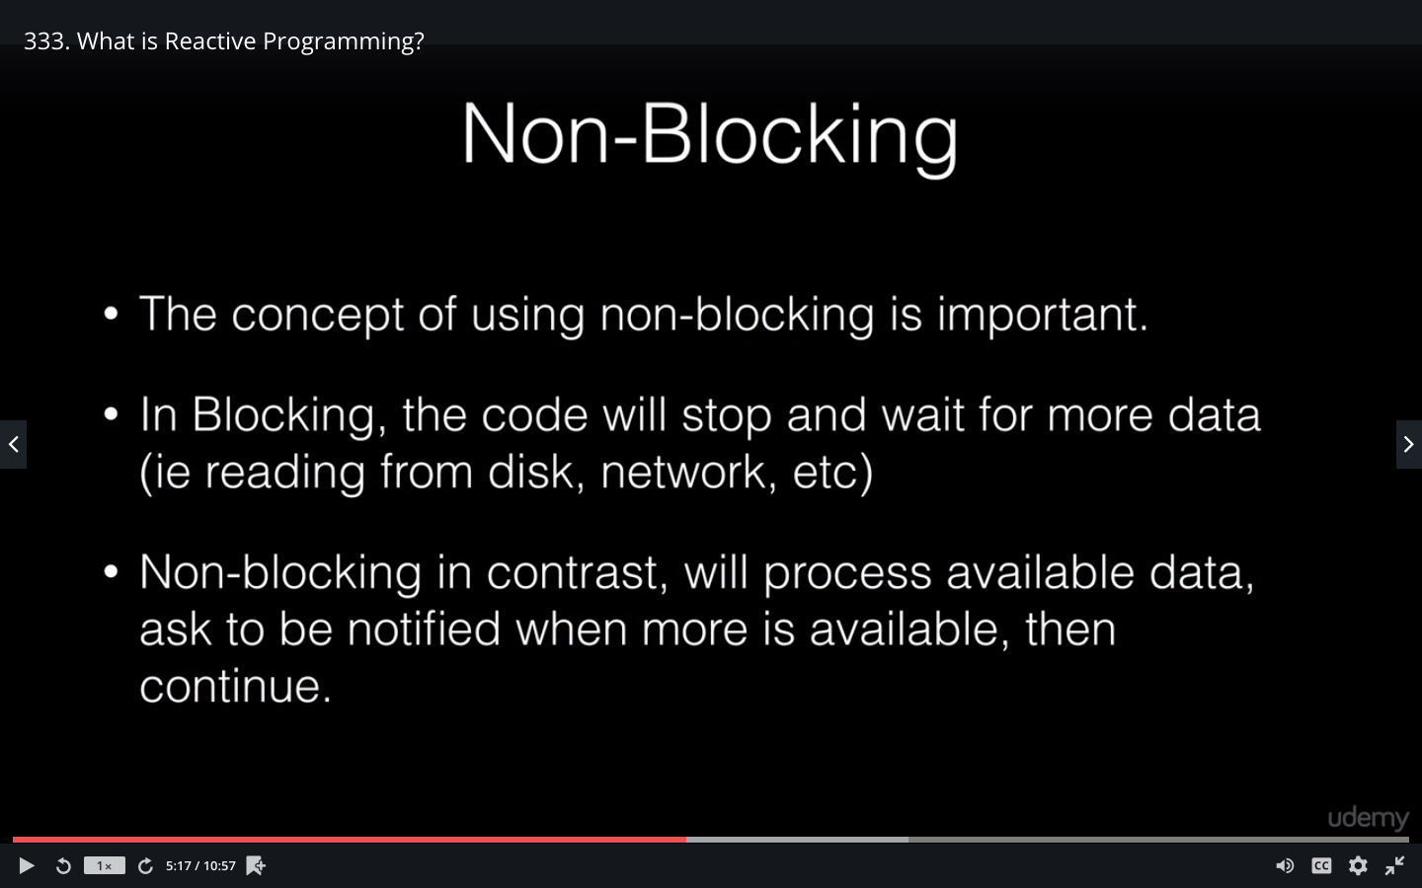

Slide 50
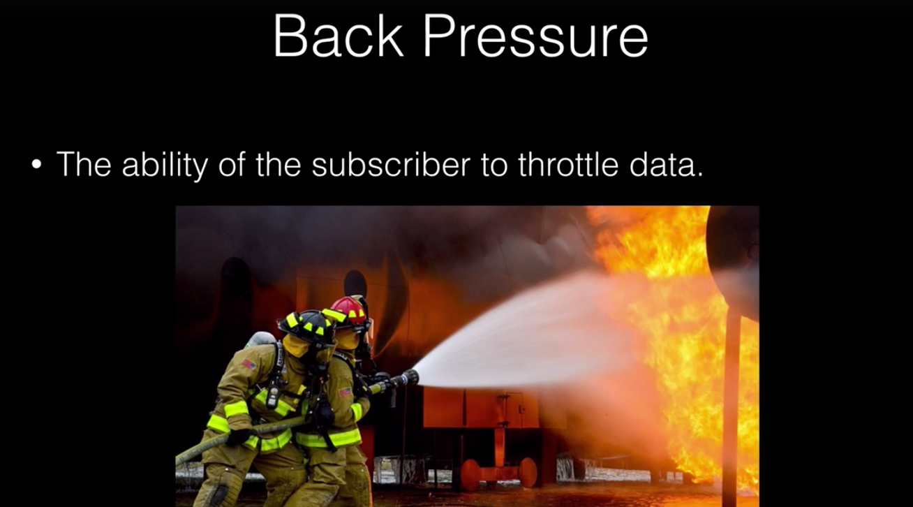

Slide 51
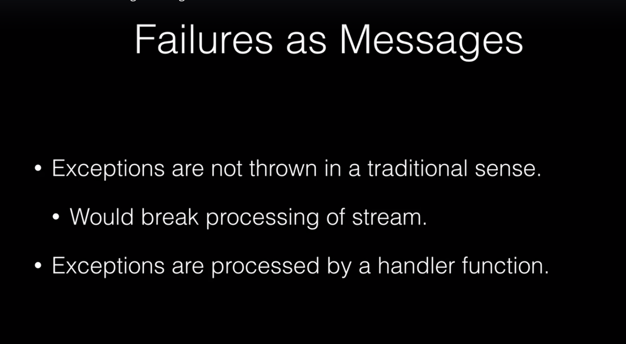

Slide 52
What Is the WebClient?
WebClient is an interface representing the main entry point for performing web requests.
It has been created as a part of the Spring Web Reactive module and will be replacing the classic RestTemplate .
The new client is a reactive, non-blocking solution that works over the HTTP/1.1 protocol.
The interface has a single implementation – the DefaultWebClient

Slide 53
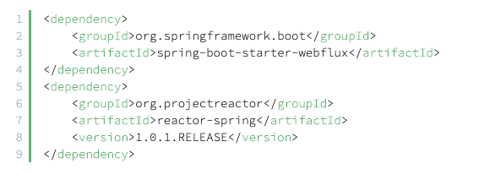
Dependencies

Slide 54
Working With the WebClient
create an instance
make a request
handle the response

Slide 55
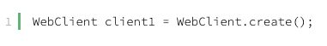
Creating a WebClient Instance
The first one is creating a WebClient object with default settings
The second alternative allows initiating a WebClient instance with a given base URI:

Slide 56
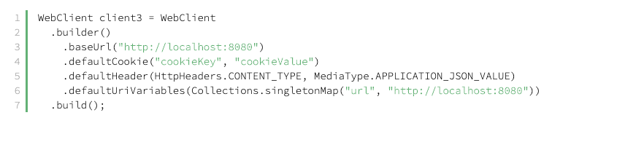
The last way (and the most advanced one) is building a client by using the DefaultWebClientBuilder class, which allows full customization:

Slide 57
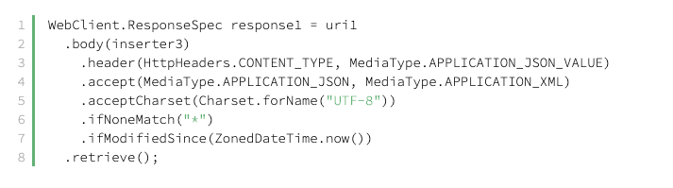
Preparing a Request
Specify an HTTP method of a request by invoking the method(HttpMethod method) or calling its shortcut methods such as get, post, delete.
Provide a URL. We can pass it to the uri API – as a String or a java.net.URL instance.
Set a request body, content type, length, cookies or headers.

Slide 58
Getting a Response
The final stage is sending the request and receiving a response.
Done with either the exchange or the retrieve methods.
They differ in return types;
exchange method provides a response along with its status headers.
retrieve method is the shortest path to fetching a body directly.

Slide 59
Mono
Mono
A Mono<T> is a Reactive Streams Publisher, also augmented with a lot of operators that can be used to generate, transform, orchestrate Mono sequences.
It is a specialization of Flux that can emit at most 1 <T> element: a Mono is either valued (complete with element), empty (complete without element) or failed (error).

Slide 60
Flux
A Flux<T> is a Reactive Streams Publisher, augmented with a lot of operators that can be used to generate, transform, orchestrate Flux sequences.
It can emit 0 to n <T> elements (onNext event) then either completes or errors (onComplete and onError terminal events). If no terminal event is triggered, the Flux is infinite.

Slide 61
Load Balancing
Server Side Load Balancing
Netscaler
Robin or Sticky session algorithm
Problem:
If one or more servers stop responding, we must manually remove those servers from the load balancer by updating the IP table of the load balancer.
we must implement a failover policy to provide the client with a seamless experience.
Client Side Load Balancing
Ribbon
Round robin or zone specific algorithm (Programmatically controlled).
The advantage is s service registry always updates itself, no manual intervention.
Notes:
1.We create a service discovery like Eureka or Consul, where each service instance registers when bootstrapped.
2. Eureka server maintains a service registry; it maintains all the instances of the service as a key/value map, where the {service id} of your microservice serves as the key and instances serve as the value.
3.If one microservice wants to communicate with another microservice, it generally looks up the service registry using DiscoveryClient
4.Eureka server returns all the instances of the calling microservice to the caller service.
5. Then it was a caller service headache which instance it calls.
Load balancing refers to efficiently distributing incoming network traffic across a group of backend servers, also known as a server farm or server pool.
A load balancer performs the following functions:
Distributes client requests or network load efficiently across multiple servers
Ensures high availability and reliability by sending requests only to servers that are online
Provides the flexibility to add or subtract servers as demand dictates

Slide 62
Server Side Load Balancing

Slide 63
Client Side Load Balancing

Slide 64
Ribbon
Client Side Load Balancer: Ribbon
Feign already uses Ribbon.
Spring Cloud Netflix creates an ApplicationContext for each Ribbon client name in our application.
AC gives the client a set of beans for instances of Ribbon components, including:
an IClientConfig, which stores client configuration for a client or load balancer,
an ILoadBalancer, which represents a software load balancer,
a ServerList, which defines how to get a list of servers to choose from,
an IRule, which describes a load balancing strategy, and
an IPing, which says how periodic pings of a server are performed.

Slide 65
central concept in Ribbon
Using the @FeignClient Annotation
Each load balancer is part of an ensemble of components that work together to contact a remote server on demand, and the ensemble has a name that you give it as an application developer (for example, by using the @FeignClient annotation).
Using RibbonClientConfiguration
On demand, Spring Cloud creates a new ensemble as an ApplicationContext for each named client by using RibbonClientConfiguration. This contains (amongst other things) an ILoadBalancer, a RestClient, and a ServerListFilter

Slide 66
1. Start with adding the dependency of ribbon in pom.xml
<dependency>
<groupId>org.springframework.cloud</groupId>
<artifactId>spring-cloud-starter-open-netflix-ribbon</artifactId>
</dependency>
2. Add the @RibbonClient Annotation in Spring Boot Application file.
3. Configure ListOfServers in Application.properties

Slide 67
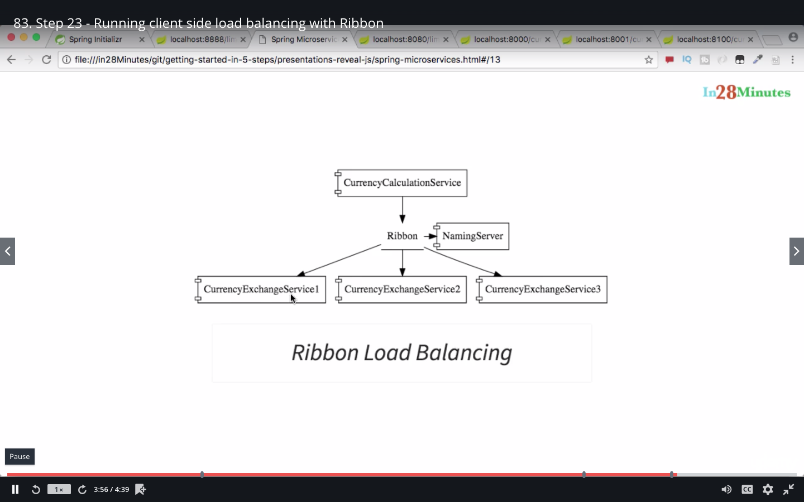

Slide 68
Eureka Server
1. Create new Component for Eureka Server.
2. Update the Currency Calculation Service to connect to Naming server.
3.Update the Currency Exchange Service to communicate to Naming Server.
4.Update the Ribbon to find the Naming Server.

Slide 69
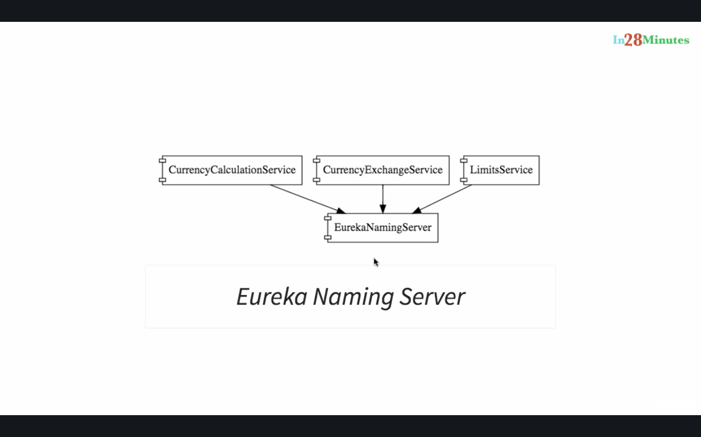

Slide 70
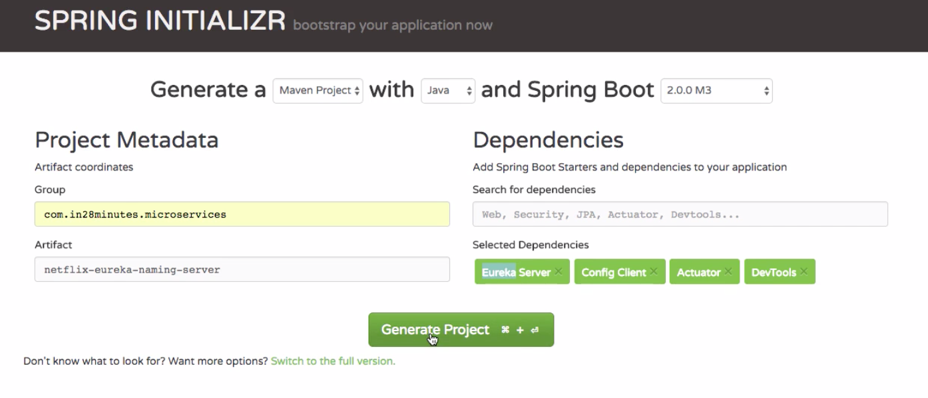
1.Generate the naming server

Slide 71
Why we need api gateway
Clients need to interact with multiple services.
Different clients need different data. For example, the desktop browser version of a product details page desktop is typically more elaborate then the mobile version.
Network performance is different for different types of clients.
The number of service instances and their locations (host+port) changes dynamically.
Partitioning into services can change over time and should be hidden from clients.
Services might use a diverse set of protocols, some of which might not be web friendly.

Slide 74
Using an API gateway has the following benefits:
Insulates the clients from how the application is partitioned into microservices.
Insulates the clients from the problem of determining the locations of service instances.
Reduces the number of requests/roundtrips. For example, the API gateway enables clients to retrieve data from multiple services with a single round-trip. Fewer requests also means less overhead and improves the user experience.
Simplifies the client by moving logic for calling multiple services from the client to API gateway.
Translates from a “standard” public web-friendly API protocol to whatever protocols are used internally

Slide 75
Drawbacks
Increased complexity - the API gateway is yet another moving part that must be developed, deployed and managed.
Increased response time due to the additional network hop through the API gateway - however, for most applications the cost of an extra roundtrip is insignificant.

Slide 76
What is Zuul ?
Routing is an integral part of a microservice architecture.
Zuul is a JVM-based router and server-side load balancer from Netflix.
Netflix uses Zuul for the following:
Authentication
Stress Testing
Dynamic Routing
Service Migration
Load Shedding
Security
Static Response handling
Active/Active traffic management
Rules and Filters can be written in essentially any JVM language, with built-in support for Java and Groovy.

Slide 77
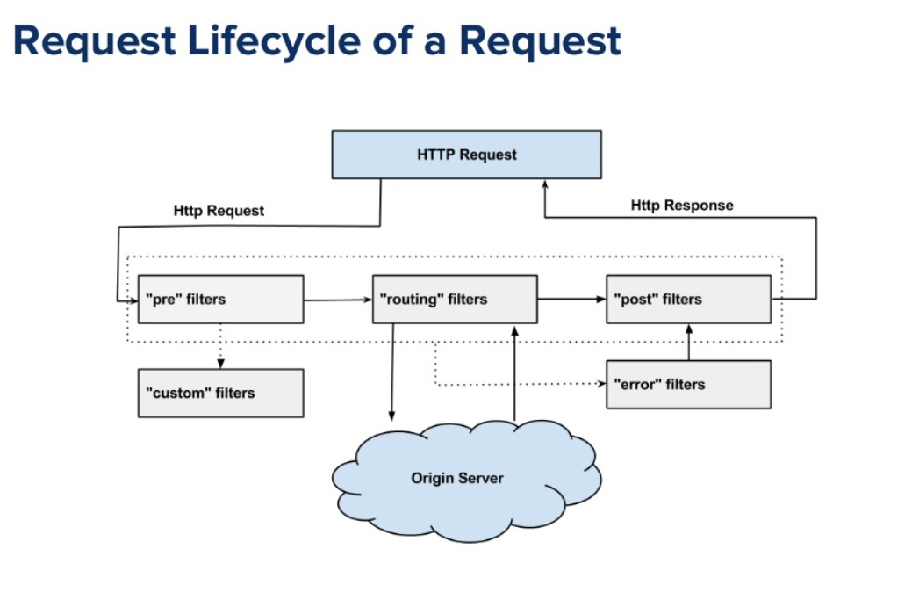
Zuul Components

Slide 78
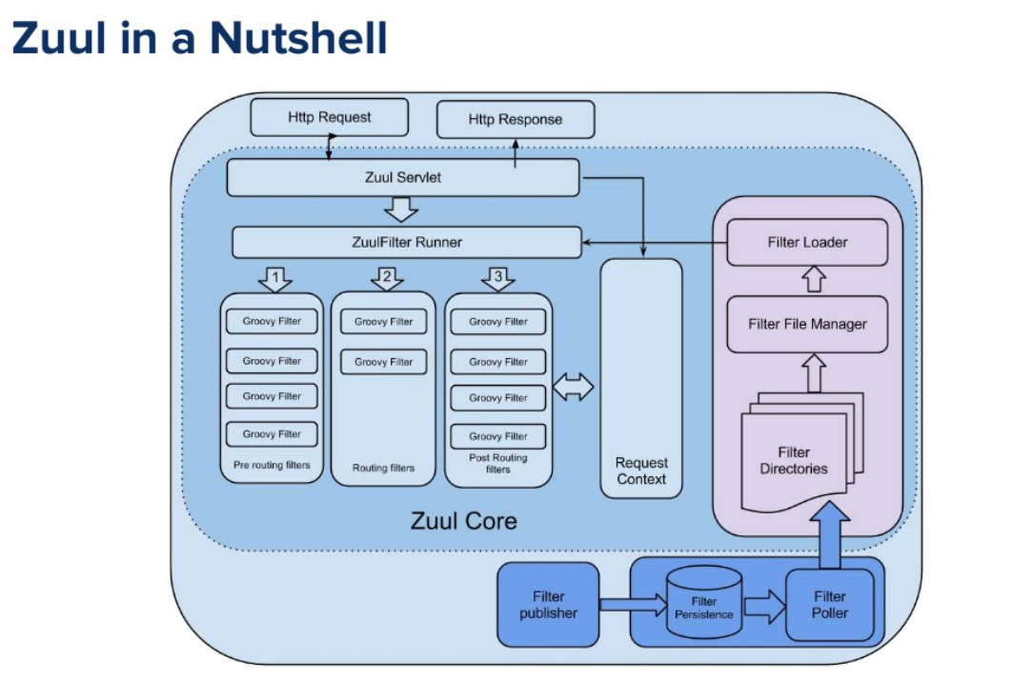

Slide 79
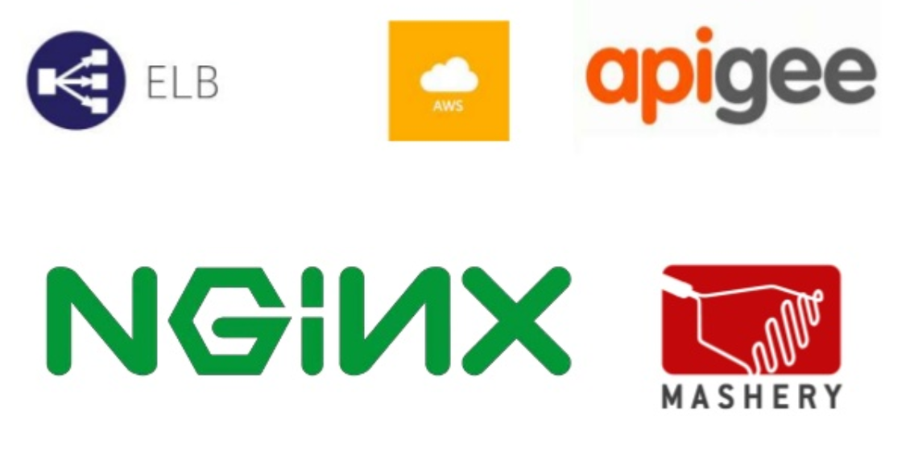

Slide 80
